Slide 1


ME5106 Engineering Acoustics
-Part2 Mini Project 3
Group 17
A0285021N Xiao Jieru
A0284918M Wang Xianghui
A0285019B Zhang Zhen
12 Nov 2023

Slide 2
Research study on acoustic monitoring in 3D printing
Analyze relationship
Literature review
of acoustic monitoring
Manufacturing
parameter
Acoustic signal
Predict manufacturing parameters based on the acoustic signal
Notes:
Analyze relationship between the manufacturing parameters and acoustic signal in laser additive manufacturing processes
Data-based method to

Slide 3
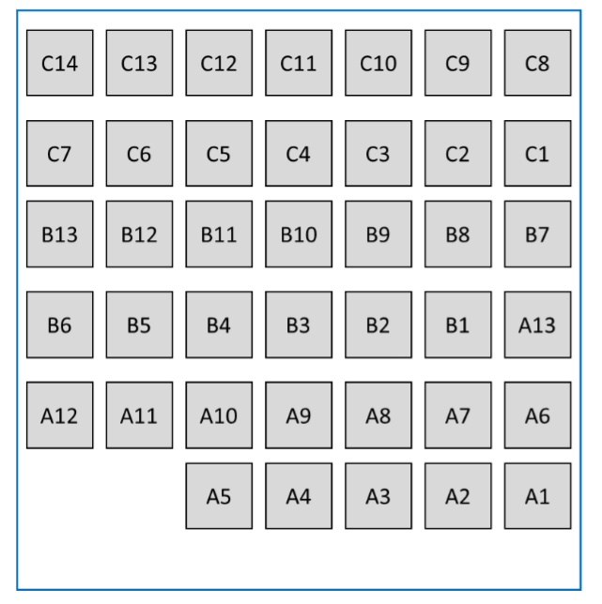
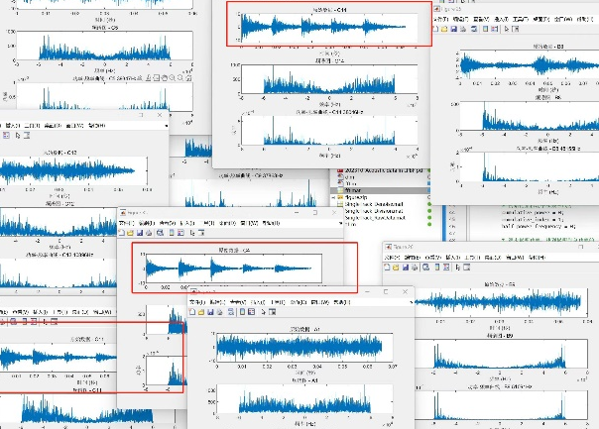
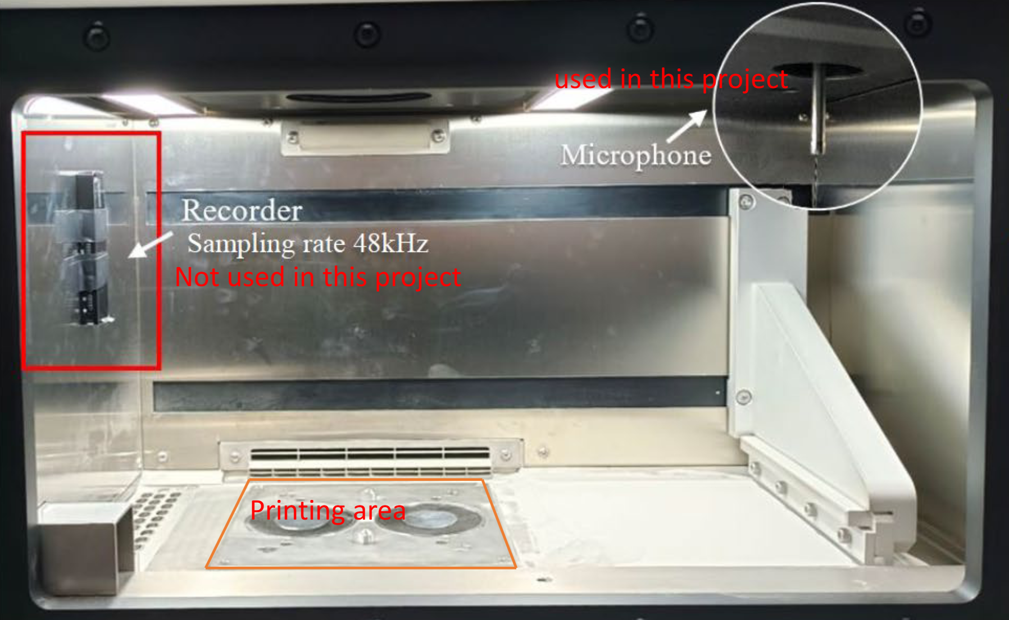
Literature Review
Process Parameters
laser power, scanning speed, layer thickness, hatch spacing etc.
Material Properties
melting point, thermal conductivity, reflectivity etc.
Printing Strategy
laser scanning paths, patterns, and sequences used etc.

Slide 4
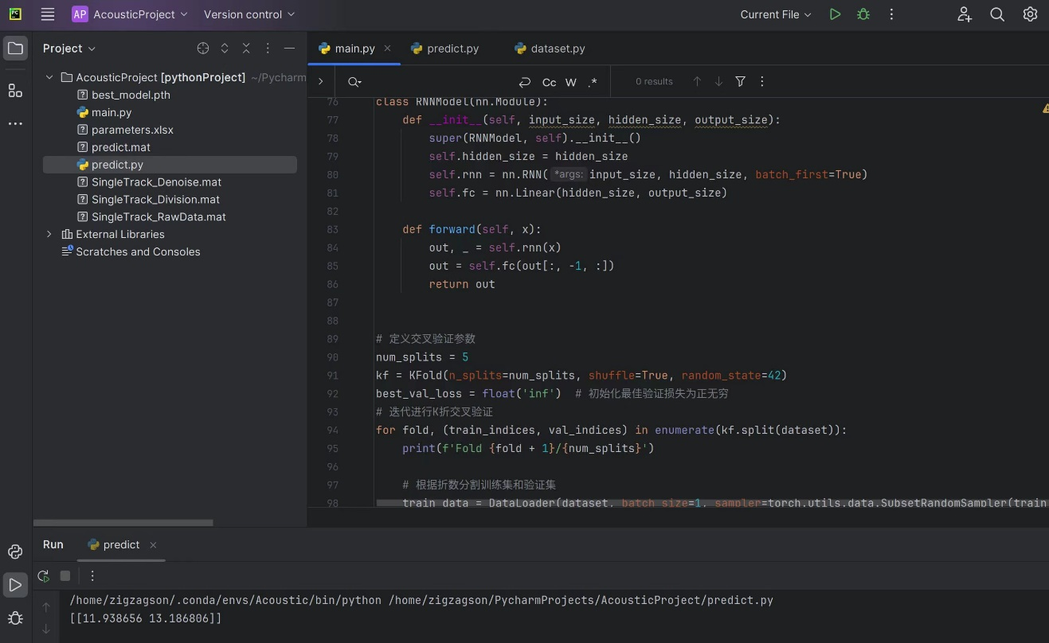
Research Process
1. Trying the traditional Deep Learning
Haven’t done any data preprocessing.
Haven’t found proper algorithms
Result not good.
Notes:
When we do this, Just a simple attempt, we haven’t got more details about the project

Slide 5
Research Process
2. Traditional Machining Learning
SCAN SPEED
Data Preprocessing
Feature extraction
LASER POWER
In terms of predicting scanning speed, it is relatively accurate.
Using an inverse proportional function added a binary function to present it.
Notes:
Sampling points

Slide 6
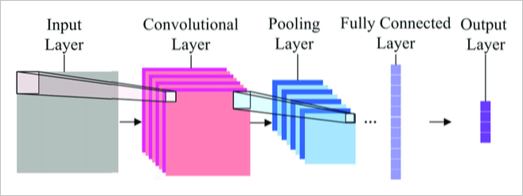
Research Process
3. MEL-CNN to predict Laser Power
In terms of predicting Laser Power, MEL-CNN structure worked well.
Notes:
Mel Frequency Cepstral Coefficients, MFCCs
Mel spectrograms can process audio signals in a manner more closely aligned with human auditory perception. MFCCs are capable of capturing local features within audio signals. In many audio analysis tasks, such as speech recognition and music classification, using MFCCs often yields better results than using the raw audio waveforms. They are designed to extract the most useful information for subsequent tasks, such as identification and classification.

Slide 7
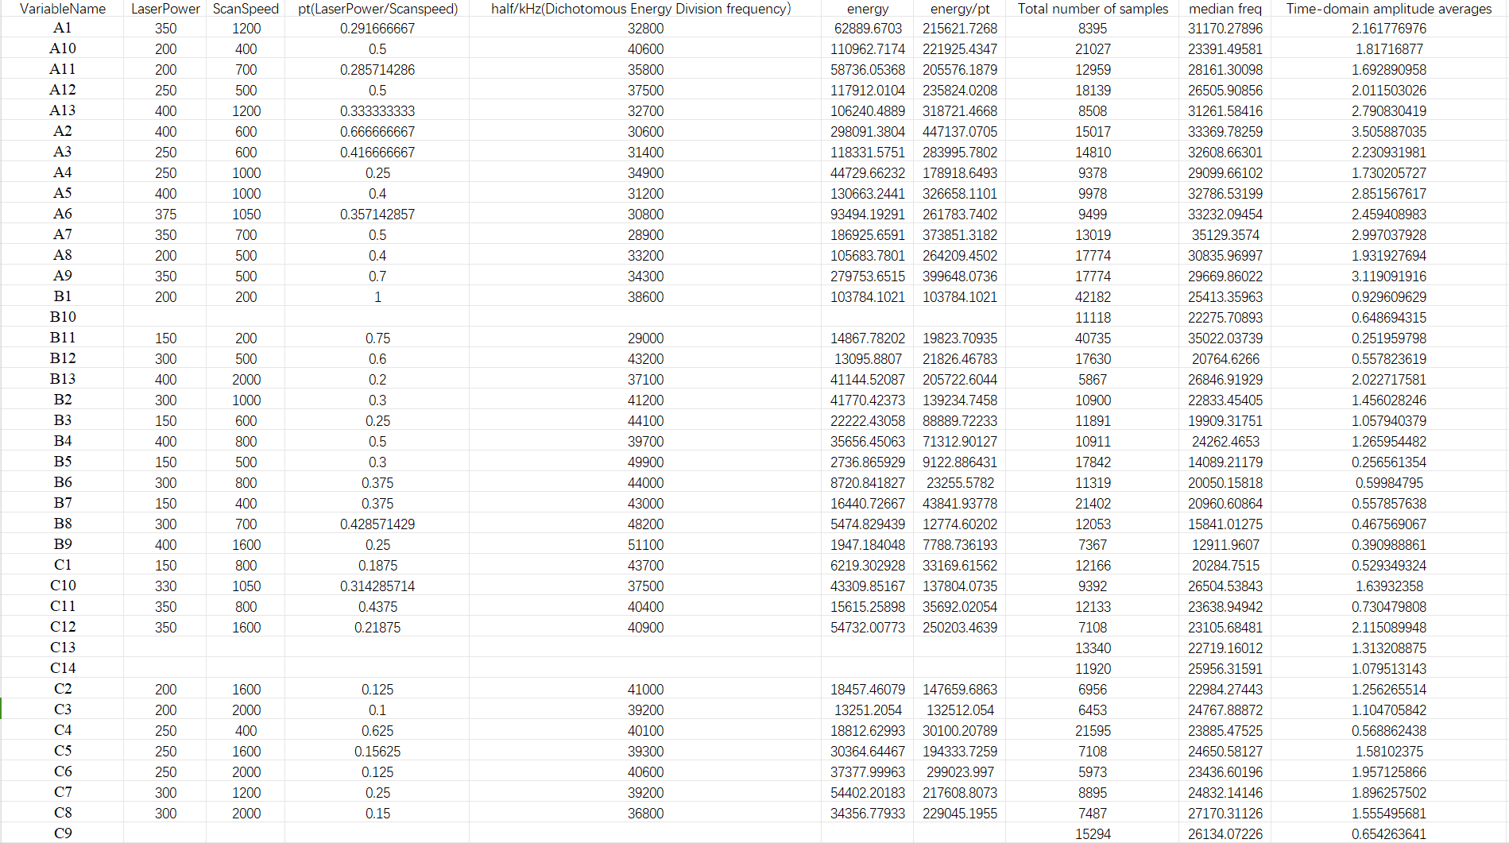
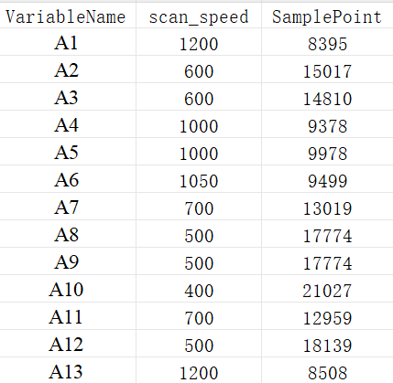
Preprocess
Data collection - creating an Excel spreadsheet
Figure 1 Feature extraction
Figure 2 Schematic diagram of the table (only Group A data)
Transforming raw data into a refined form, facilitating subsequent analytical tasks and enhancing predictive modeling accuracy
Notes:
This is a part of our data preprocessing where we extract features from the raw data that have an impact on predicting the target variable. Firstly we started to focus on analysing the relationship between the number of sampling points and the scanning speed. Intuitively, the number of sampling points decreases as the scanning speed increases. So we created a new table from the larger one to further refine the data to be investigated, you can see that there is the number of sampling points and scanning speed in this little spreadsheet. We first do the prediction of scanning speed.

Slide 8
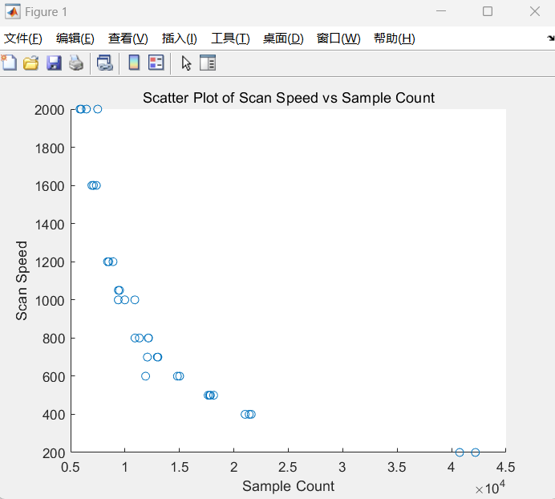
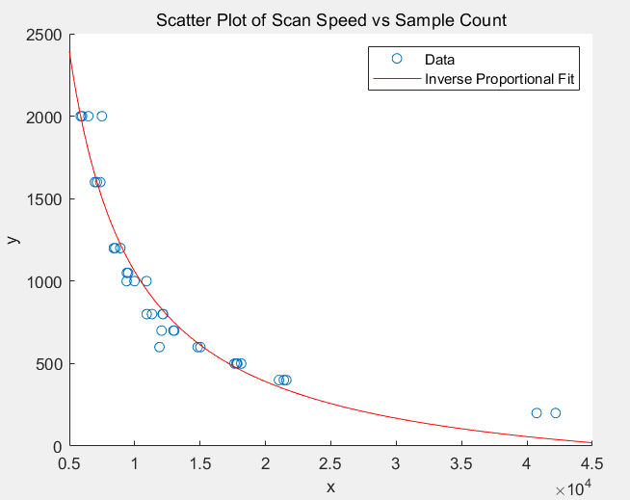
Scan speed
Visualization and regression - Inverse proportional function
An inverse proportion intuitively relates scanning speed to sampling points
Sampling points decrease as laser scanning speed increases
Figure 2 Data Potential Relationships
Notes:
Next, we looked at the relationship between the number of sampling points and the scanning speed by plotting a scatter plot. The scatterplot shows a clear inverse relationship, which means that as one variable increases, the other decreases, and this relationship is consistent with the basic characteristics of an inverse proportion function.

Slide 9
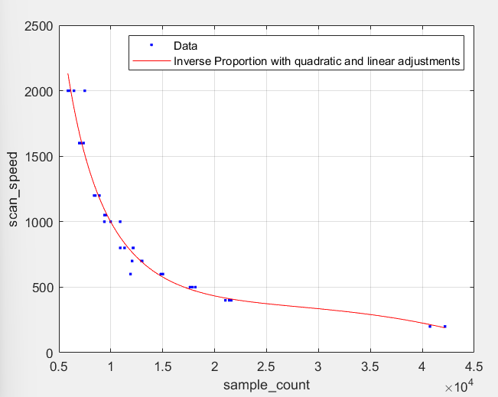
Scan speed
Regression and Optimization - Combining Inverse Proportion with quadratic and linear adjustments
The complex relationship between sampling points and scanning speed is modeled considering primary inverse trends, nonlinear adjustments with quadratic and linear terms, and a baseline shift via a constant.
Figure 3 Regresssion and Optimization
Notes:
In regression analyses using the inverse proportion function, we note that noise in the actual data causes the observations to be distributed on both sides of the ideal inverse proportion function curve. In the real world, data often deviate from the theoretical model due to various random factors or uncontrollable variables. For this reason, we began to explore ways to correct the fitted function.
In order to better fit the actual data, we added quadratic, primary and constant terms to the inverse proportion function. Doing so can help correct and compensate for noise and other effects of variables not accounted for in the data. The model after modificatioin was able to describe the relationship between the data more accurately and showed good results in prediction.

Slide 10
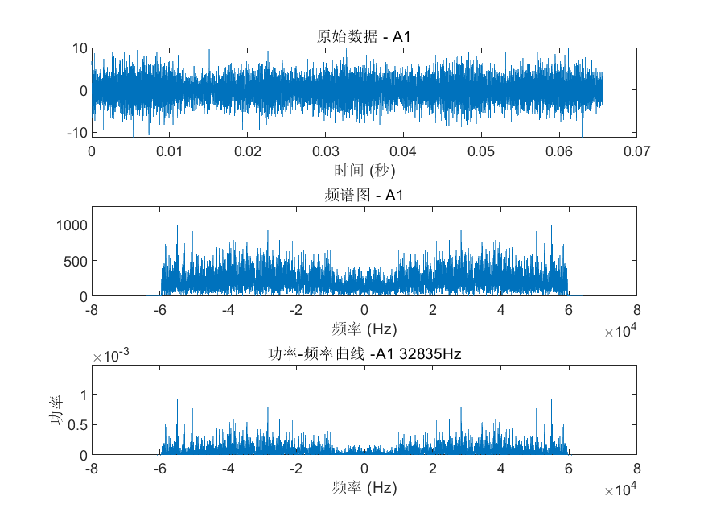
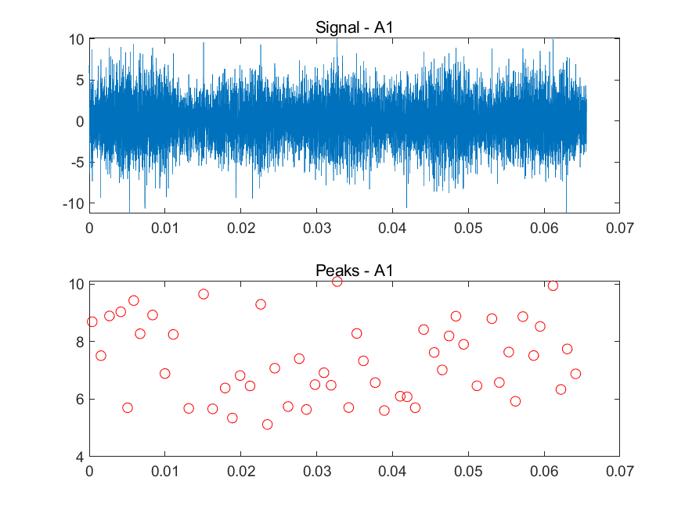
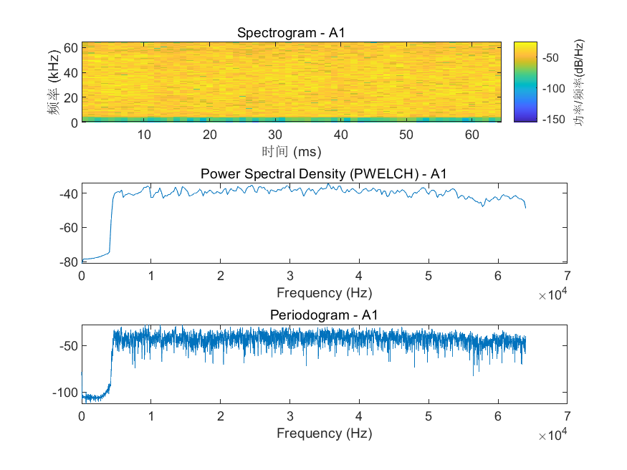
Laser power
Data Visualization
Time-domain waveform - Helps to identify the cyclical, fluctuating nature of the signal and any possible anomalies
Spectrum - Reveals the strength of different frequency components in a signal and is used to identify major frequencies and harmonics in a signal
Spectrogram - Facilitate the identification of predominant frequency constituents in a signal and ascertains the inclusion of specific frequency elements
Power Spectral Density - Indicates the power distribution of the frequency components of a signal, usually used to analyse the energy distribution of a random signal or noise
Notes:
For the prediction of power, we also extracted a number of features
The time-domain waveform is instrumental in identifying the cyclical and fluctuating nature of a signal, as well as pinpointing any potential anomalies that may be present. Meanwhile, the spectrum is key to revealing the strength of different frequency components within the signal, facilitating the identification of major frequencies and harmonics. The spectrogram further aids this process by helping to identify the predominant frequency constituents of the signal and confirming the presence of specific frequency elements. Additionally, the power spectral density serves an important role by indicating how the power is distributed among the signal's frequency components, which is typically utilized to analyze the energy distribution of random signals or noise. But the correlation between these features and power is not particularly significant.

Slide 11
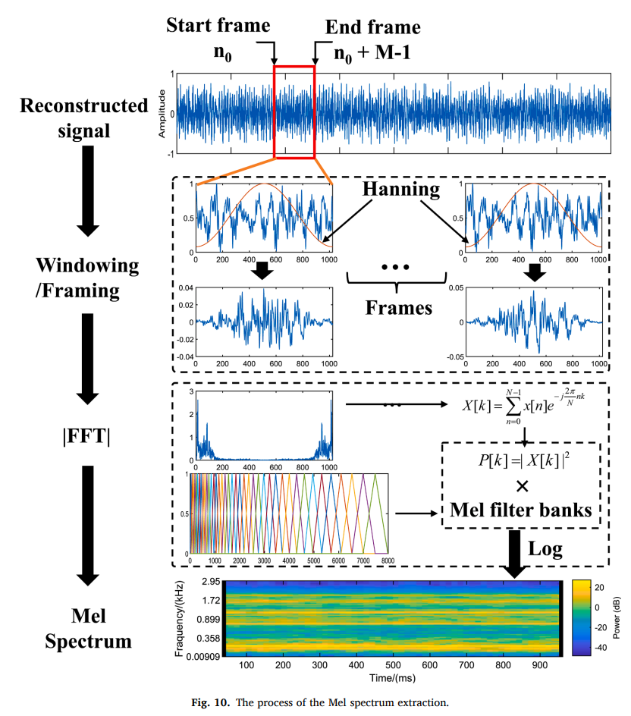
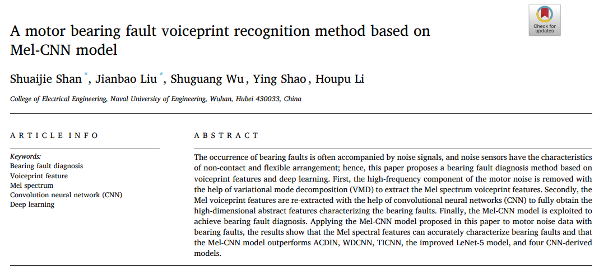
Mel-CNN
MEL-CNN for Sound Feature Extraction
Notes:
In the process of literature review, we found an article based on noise sequence analysis of fault sources, the article used CNN to extract Mel map features to extract the features of noise. Mel map is a variation of spectrogram, which represents the energy distribution of audio signal at different frequencies. The horizontal axis usually represents time, the vertical axis represents frequency, and the color or brightness represents signal strength at each point in time and frequency. That got us interested in trying CNN. When we try to input audio sequence directly to RNN model before, the effect may be poor because of insufficient feature extraction. But typing in a Mel graph is equivalent to typing in a more obvious feature, and the required network is simpler.

Slide 12
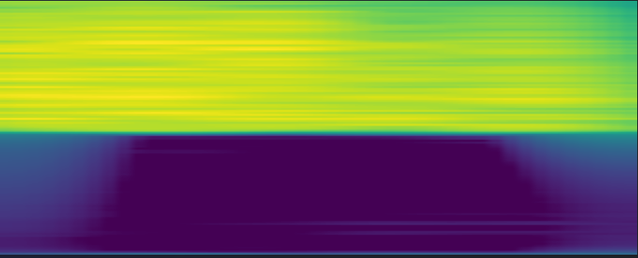
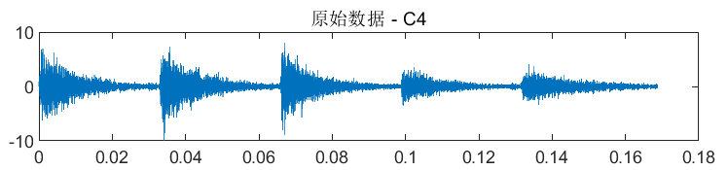
Mel-CNN input
Sound sequence
Python librosa
Mel-spectrum
Notes:
We used the librosa library in Python to draw Mel diagrams of each sound sequence, in the form of PNG, and then fed them into our designed CNN model.

Slide 13
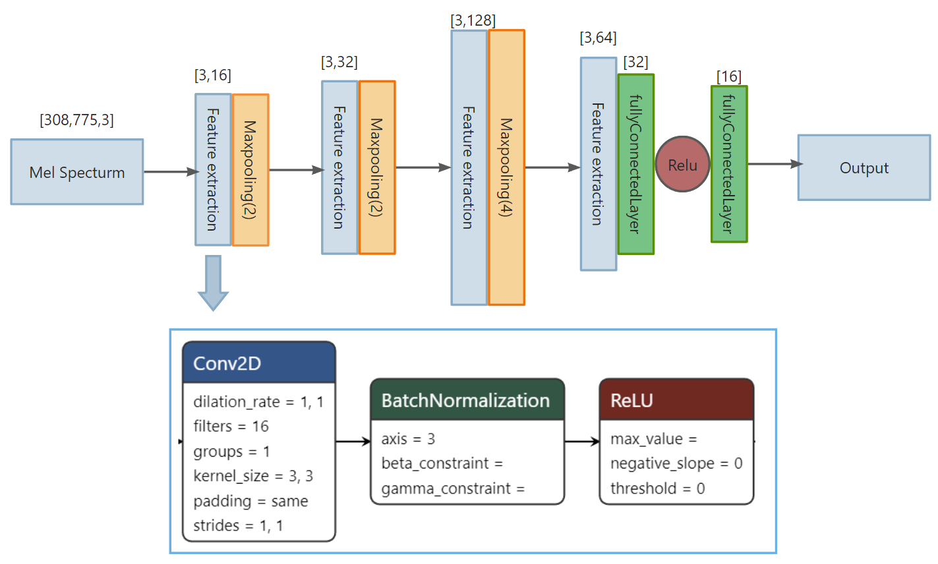
Mel-CNN structure
Notes:
In the CNN model we designed, there are multiple feature extraction blocks. Each block contains a two-dimensional convolution layer, batchnormalization, and a relu activation function. Maxpooling is used after each feature extraction block to reduce dimensionality and reduce unnecessary parameters. Finally, the feature data are expanded and the predicted results are output by the full-connection layer in the regression layer

Slide 14
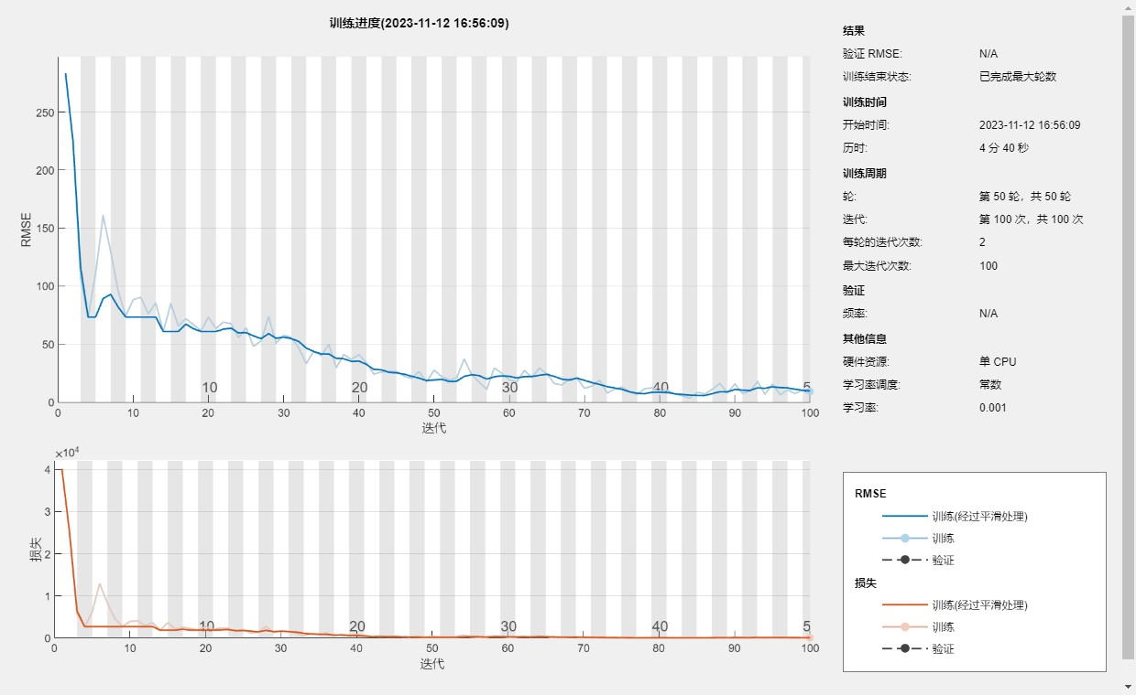
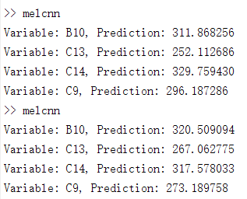
Mel-CNN training result
Laser Power Predict Result:
C9: 285
C13: 323
C14: 259
Notes:
This is our training process and the results of the training, we combined the results of multiple predictions, the results:

Slide 15
ME5106 Engineering Acoustics
-Part2 Mini Project 3
Thank You!
A0285021N Xiao Jieru
A0284918M Wang Xianghui
A0285019B Zhangzhen
12 Nov 2023

